Slide 1
RESPONSE WEB: REcommendation System for Predicting the Price based ON Scrapping E- commerce WEBsites
SUBMITTED BY:
KIRAN R(01JCE21CS052)
PRASHANTH M(01JCE21CS074)
MOHAMMED AMEEN AHMED(01JST22UCS149)
M V NAGAVARDHAN VASIST(01JCE21CS058)
UNDER THE GUIDANCE OF :
Prof. NANDEESH H D
UNDER THE GUIDENCE OF :
Prof. NANDEESH H D

Slide 2
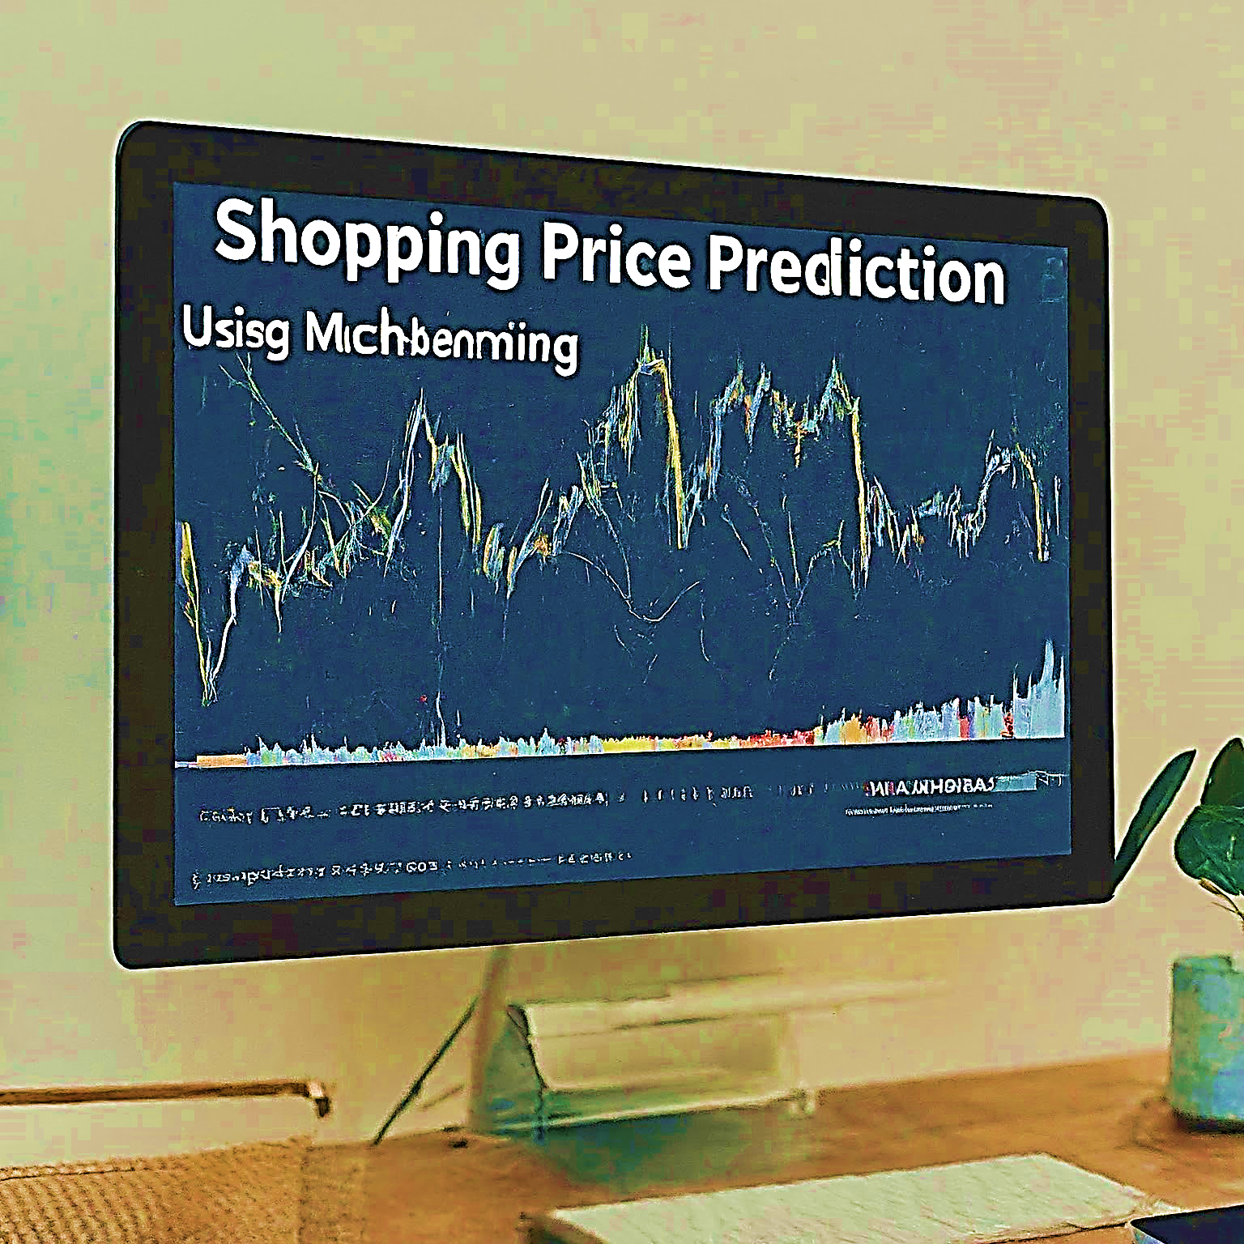
INTRODUCTION
What is a Shopping Price Prediction?
Applying machine learning algorithms to forecast the price of a product.
Helps understand market trends, optimize pricing strategies, and inform consumer decisions.
Benefits of Shopping Price Prediction
Businesses: Dynamic pricing, targeted promotions, inventory management.
Consumers: Informed purchases, budgeting, identifying deals

Slide 3
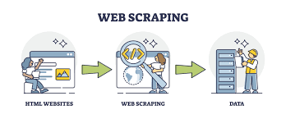
LITERATURE REVIEW
Web scraping techniques.
Preprocessing Methods.
Machine Learning Models for Price Prediction.
Evaluation Metrics.
Deployment Strategies.

Slide 4

LIMITATION OF THE PRESENT WORK
Focus on a specific product category
Model might not capture sudden price fluctuations due to external factors.
Data quality and availability.
Adding Server delays.
Asynchronous Scrapping Techniques.

Slide 5

OBJECTIVES OF THE PRESENT WORK
Data set generation.
Develop a machine learning model to predict the price of shopping items within a specific category.
Evaluate the performance of the model using relevant metrics.
Analyze the factors that significantly influence product pricing.
Provide insights on how businesses and consumers can utilize price prediction.

Slide 6
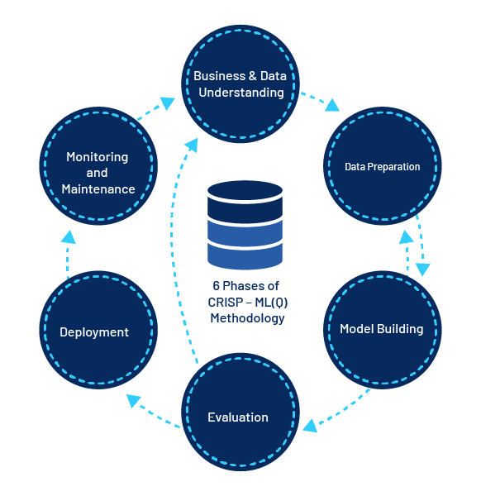
METHODOLOGY
Data Collection
Data Preprocessing
Feature Engineering
Model Selection & Training
Model Evaluation
Deployment

Slide 7
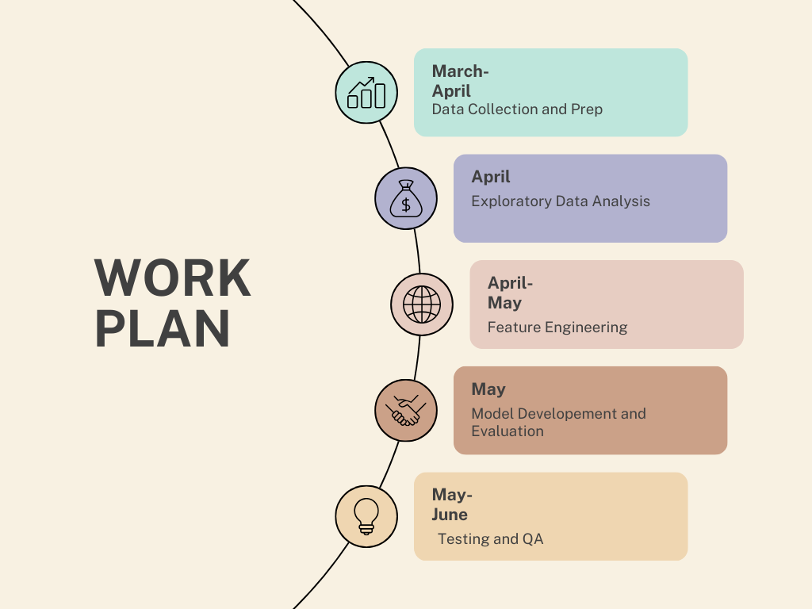

Slide 8
CONCLUSION
Apart from price prediction we can suggest the link of similar products. If it’s a new product we might as well return the marketing demand and scope of that product.
More data can be added either by going through all the pages in the footnote or adding product info from multiple sites.
Trying to fit more robust models, which may lead to better results.
Explore the application of the model to a broader range of product categories.

Slide 9
REFERENCES
Web scraping techniques: A literature review. International Journal of Advanced Computer Science and Applications, 6(5), 65-70.Yang, J., Wei, Y., Qin, Y., & Zhang, Y. (2019).
Deep learning for e-commerce. In Proceedings of the 27th ACM International Conference on Information and Knowledge Management (pp. 187-196).Chen, Z., Liu, Y., & Zhang, Y. (2020).
Price prediction in e-commerce: Challenges and opportunities. IEEE Transactions on Big Data, 6(1), 87-96.Gupta, A., Kumar, A., & Garg, A. (2019).
A comparative study of machine learning models for e-commerce price prediction. International Journal of Computer Applications, 180(32), 38-43.

Slide 10
THANK YOU
••••

